Slide 1
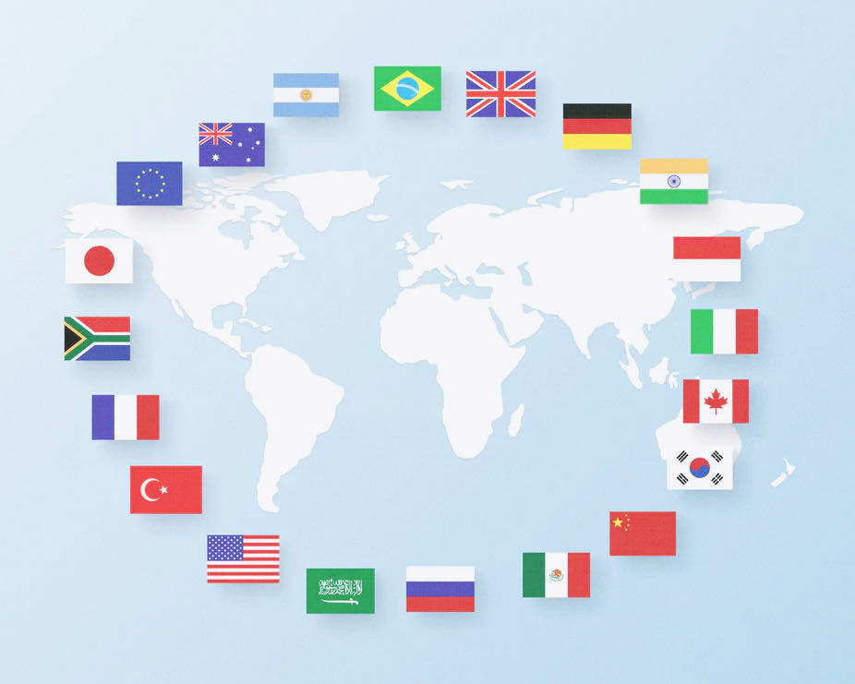

Education, Healthcare and Military Spending
An Analysis of G20 Countries from 2011 to 2016
By Ruijin Jia
Visualization of Complex Data_DATS_6401
Instructor: Nima Zahadat, Ph.D.

Slide 2
Overview
01
part
GDP, Military, Educational and Healthcare Spending

Slide 3
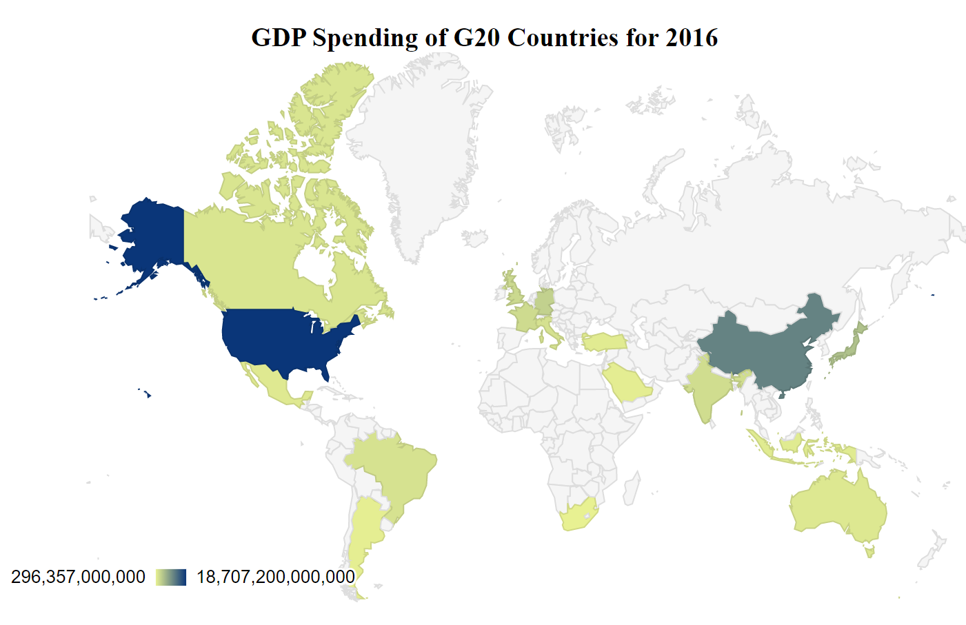
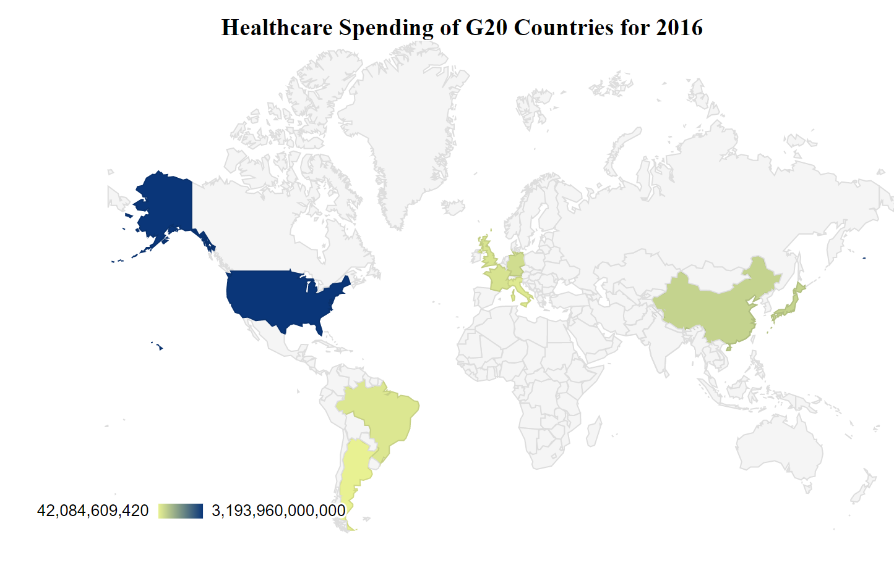
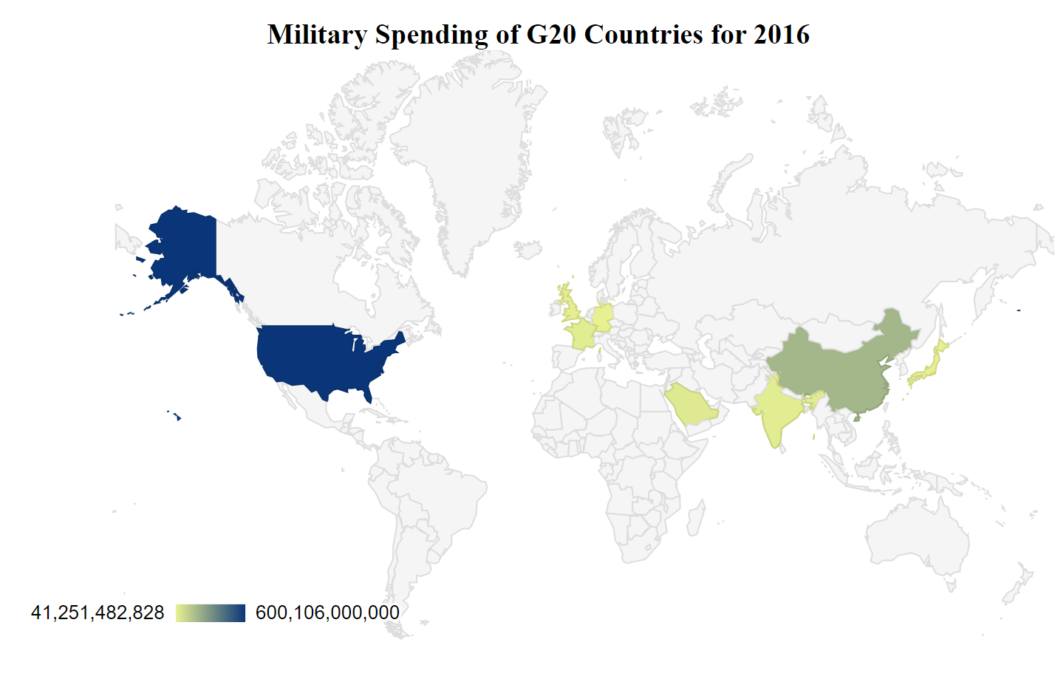
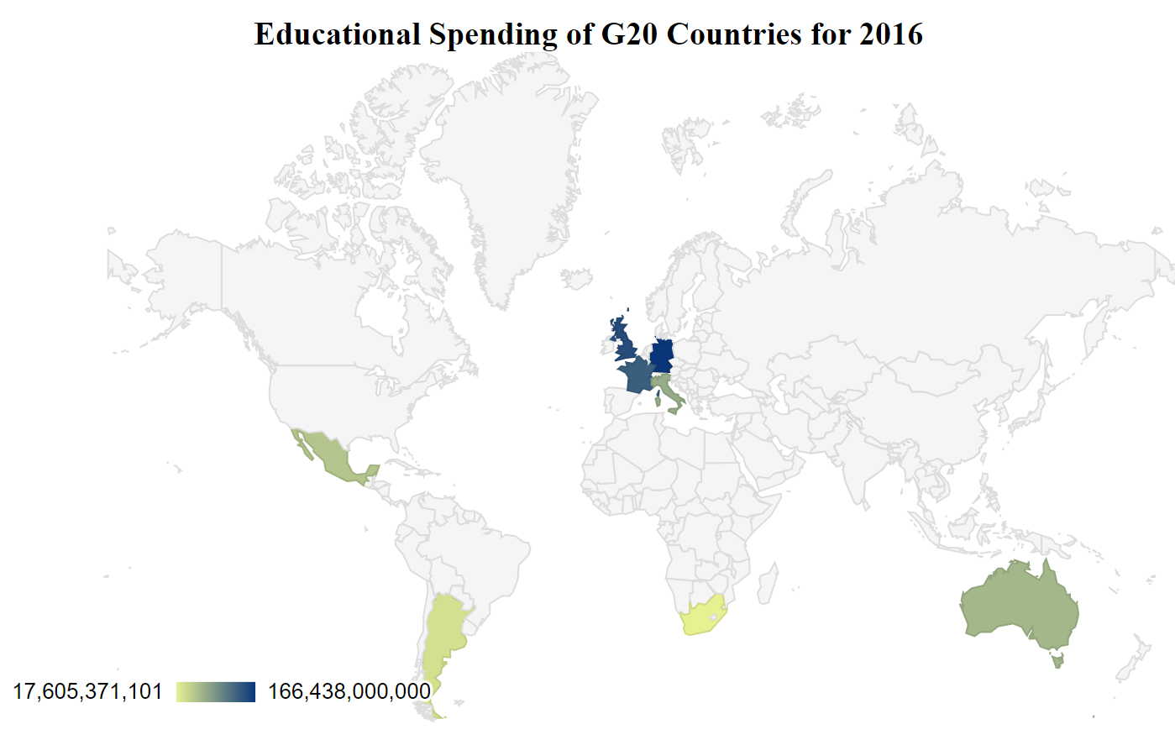

Slide 4
02
part
Healthcare

Slide 5
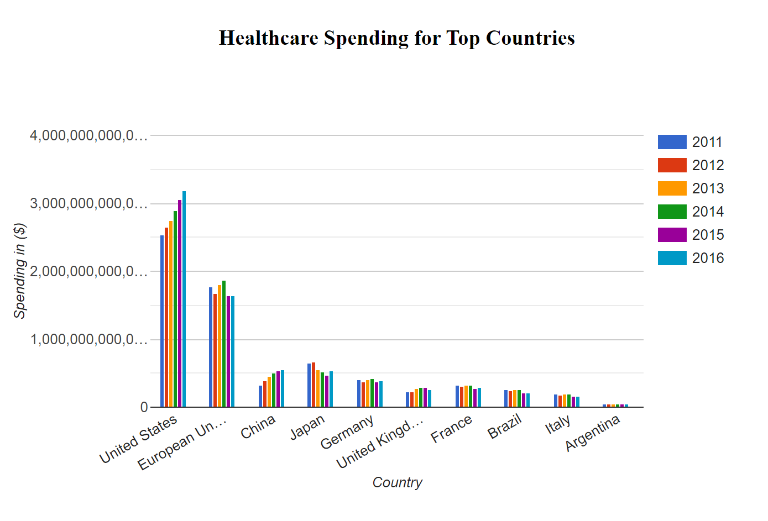
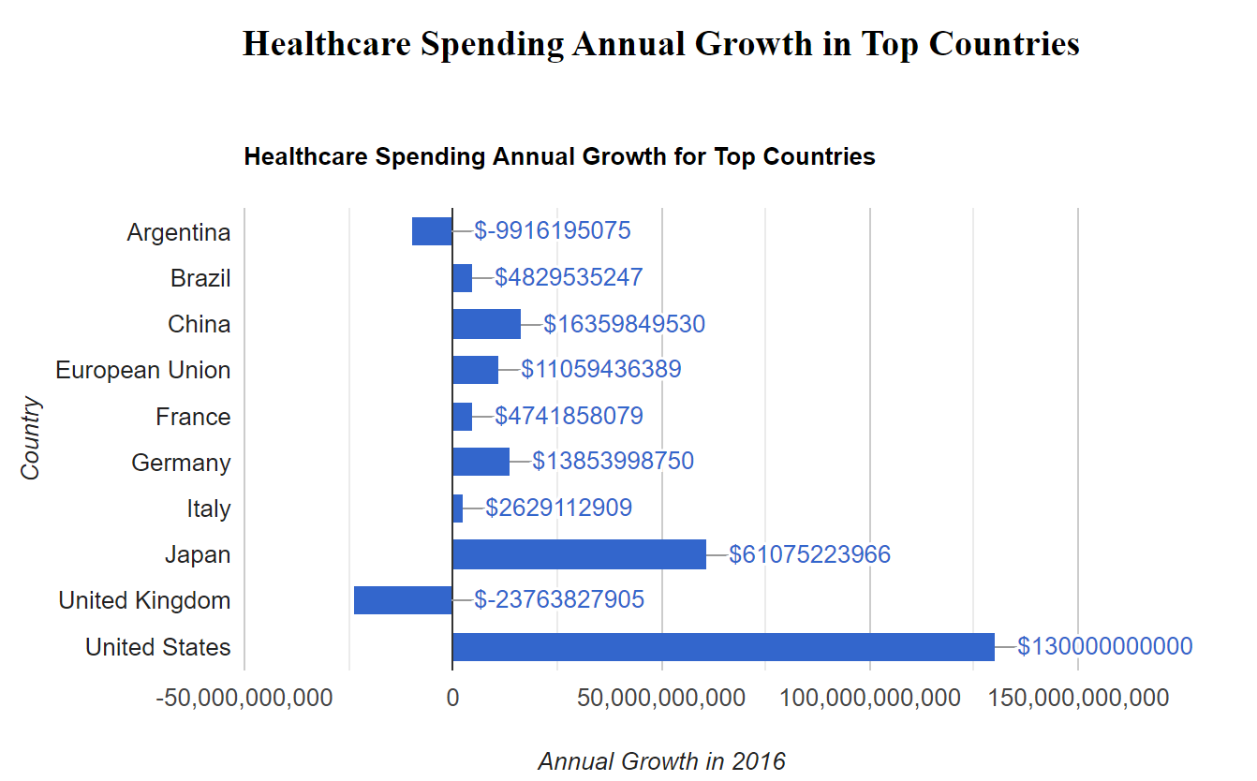
02
Healthcare Spending VS GDP

Slide 6
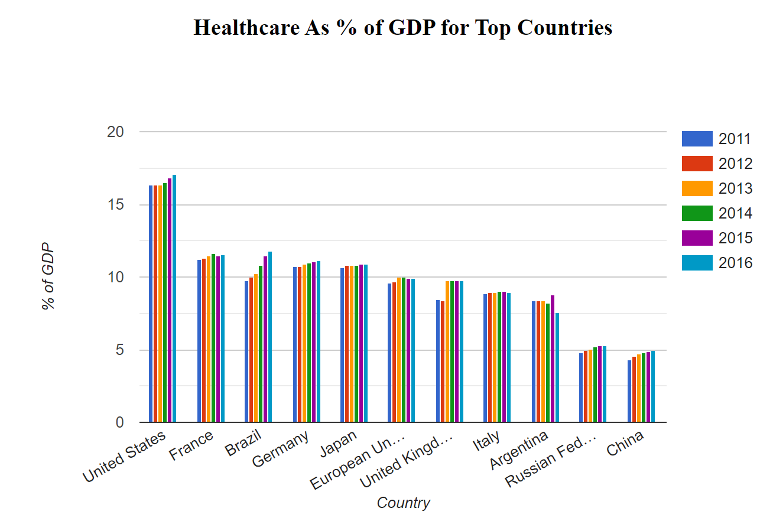
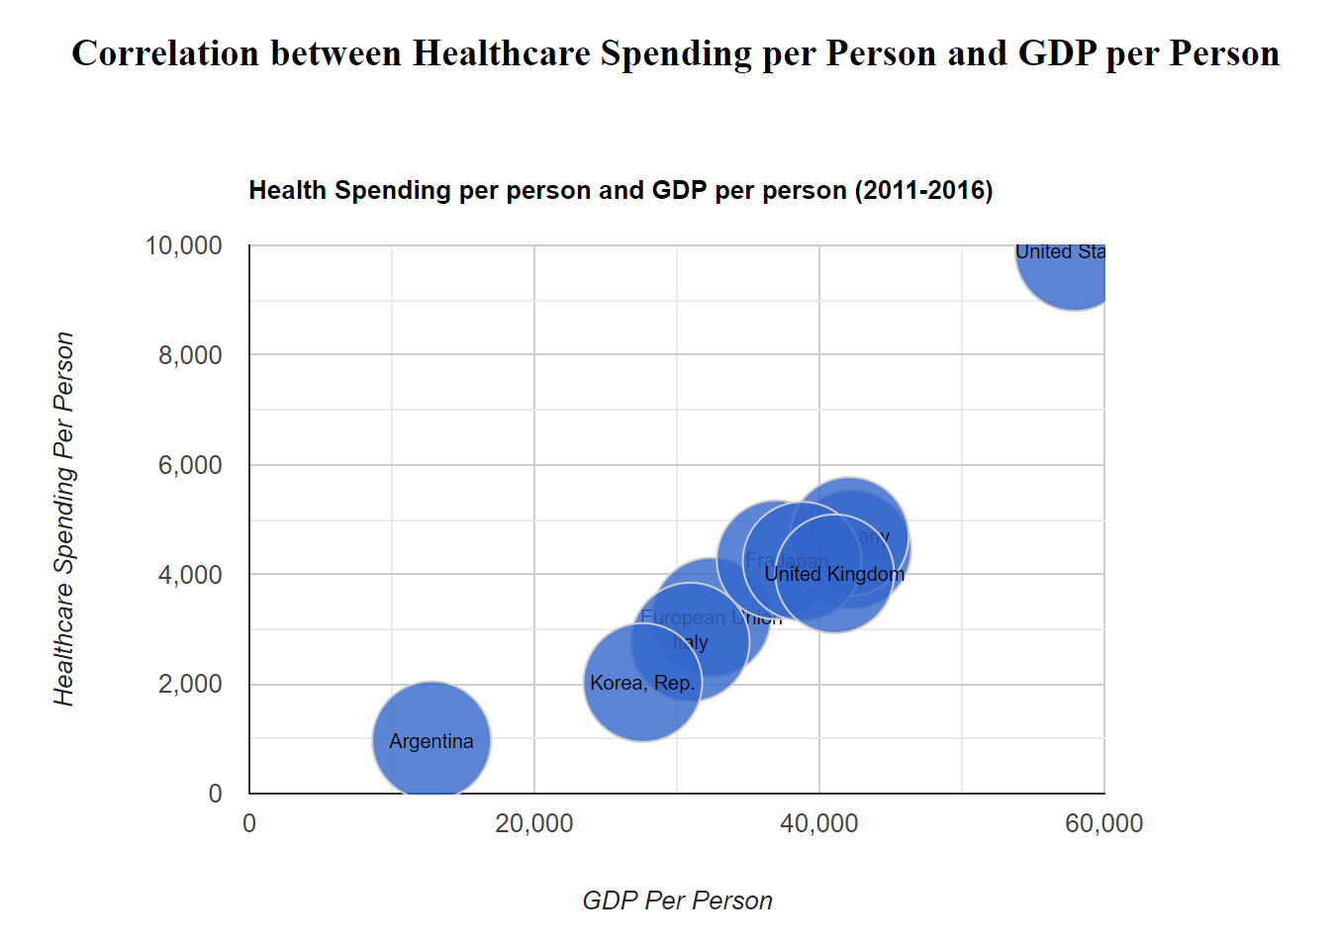
02
Healthcare Spending VS GDP Per Capita

Slide 7
03
part
Educational Spending

Slide 8
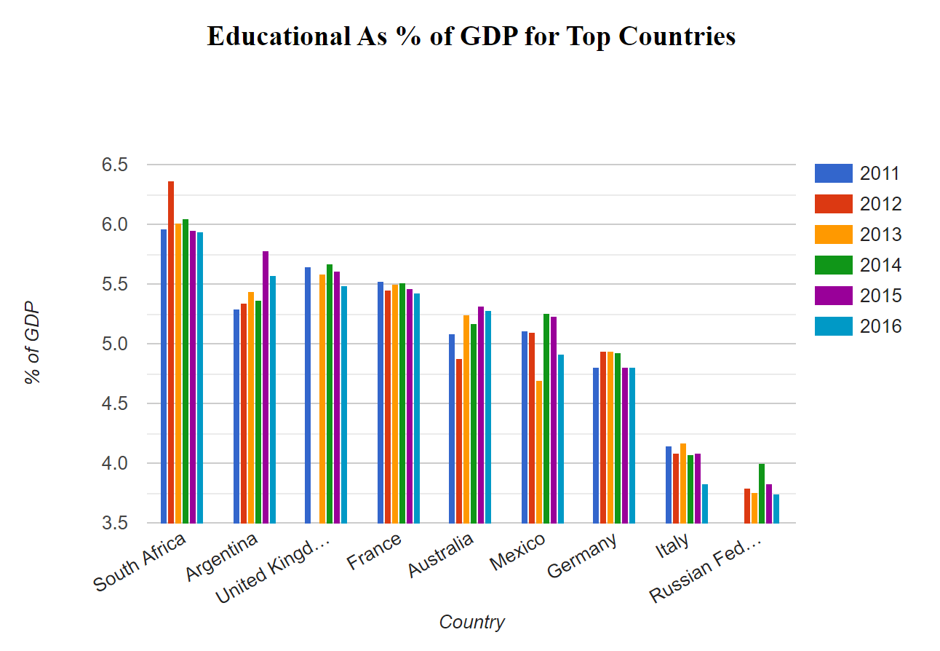
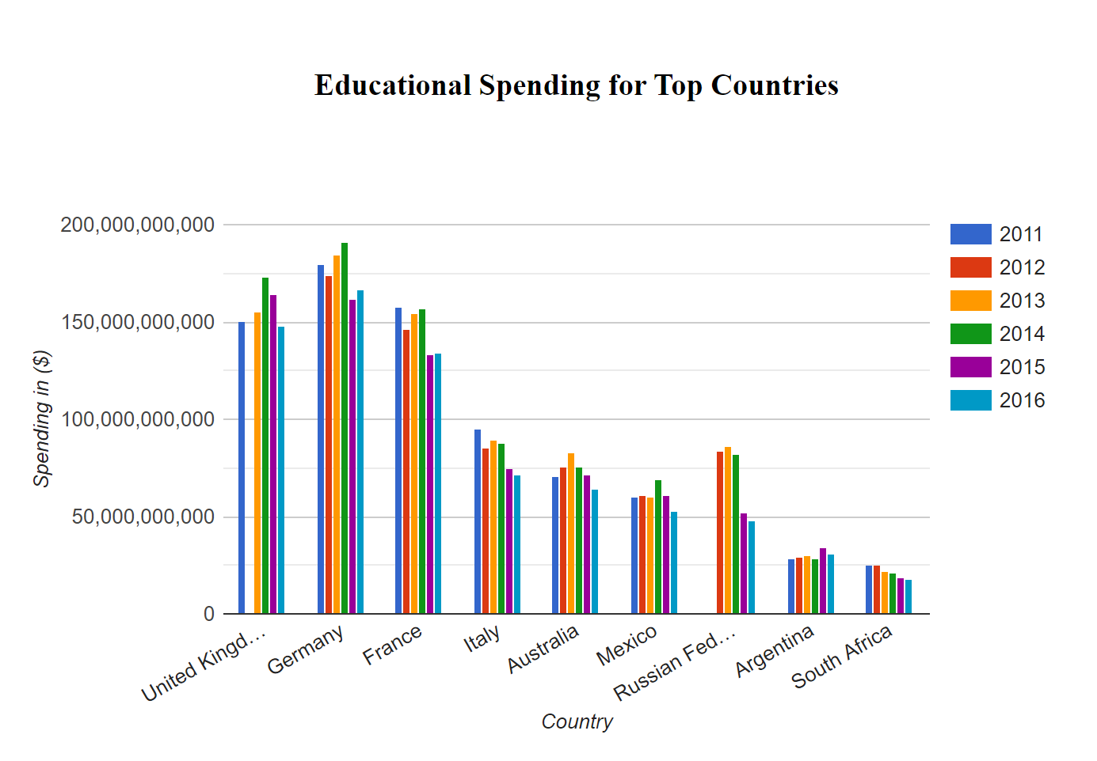
03
Educational Spending VS GDP

Slide 9
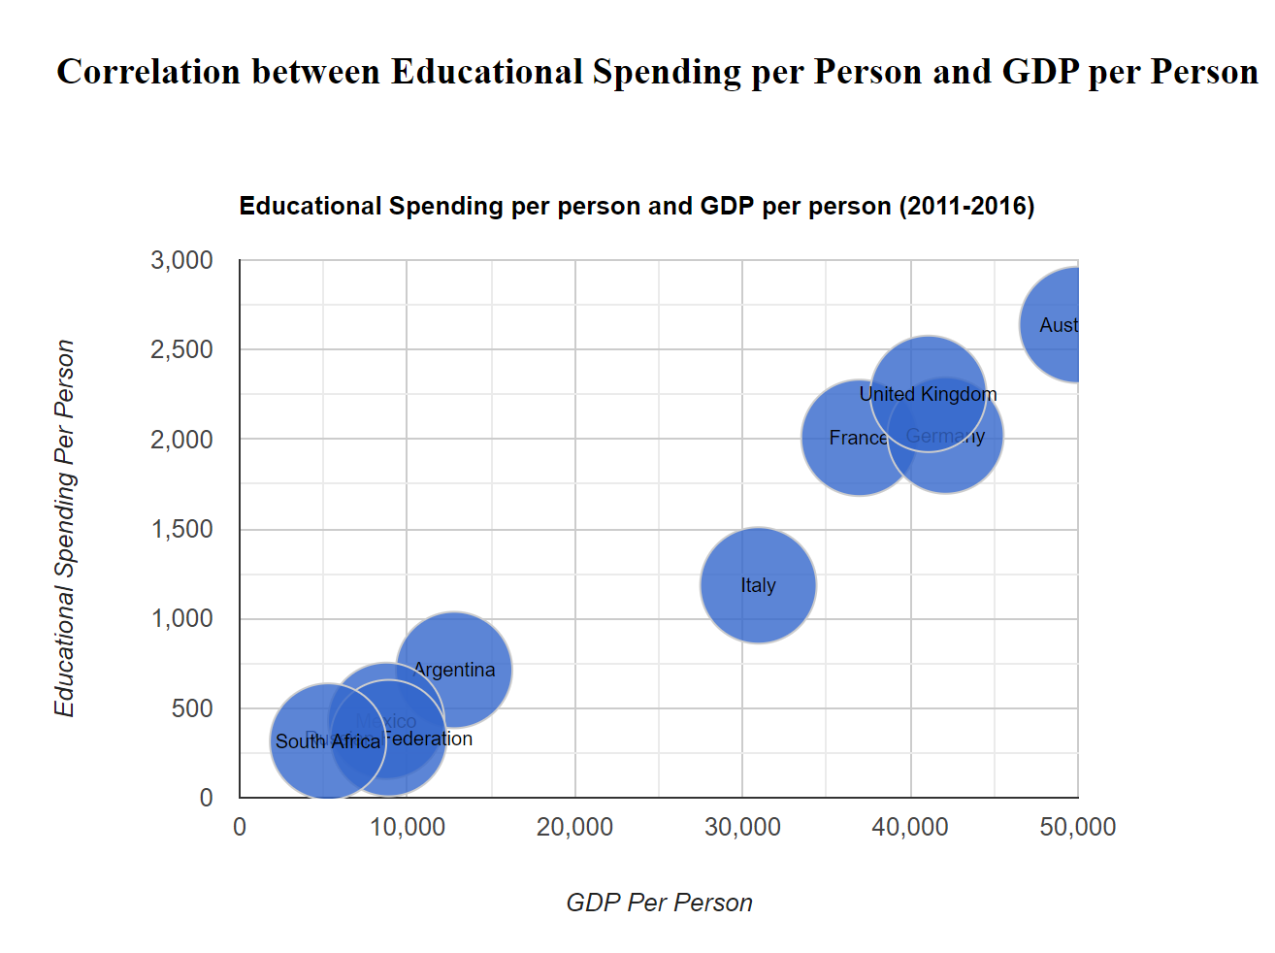
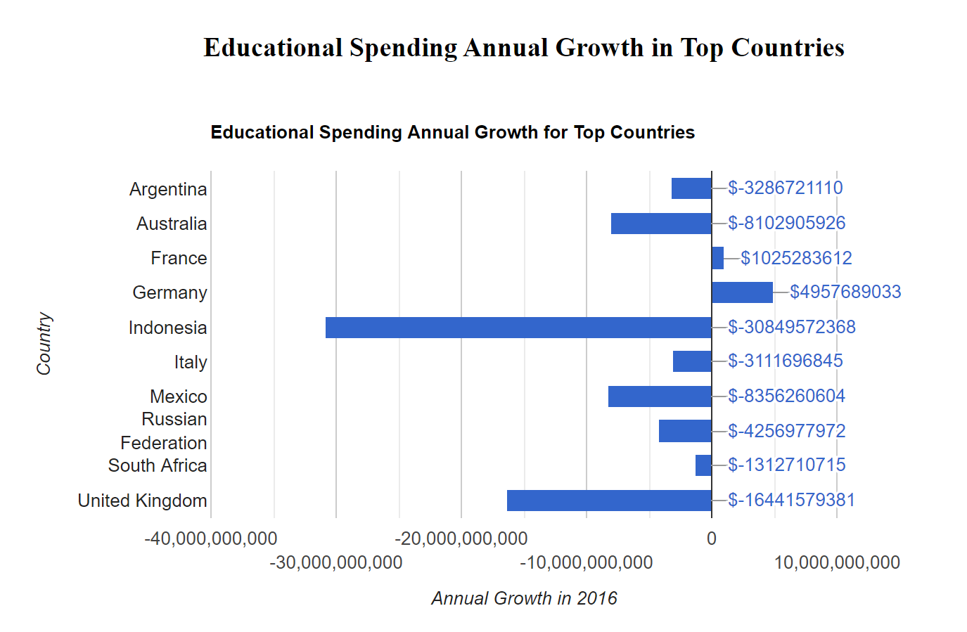
03
Educational Spending VS GDP Per Capita

Slide 10
04
part
Military

Slide 11
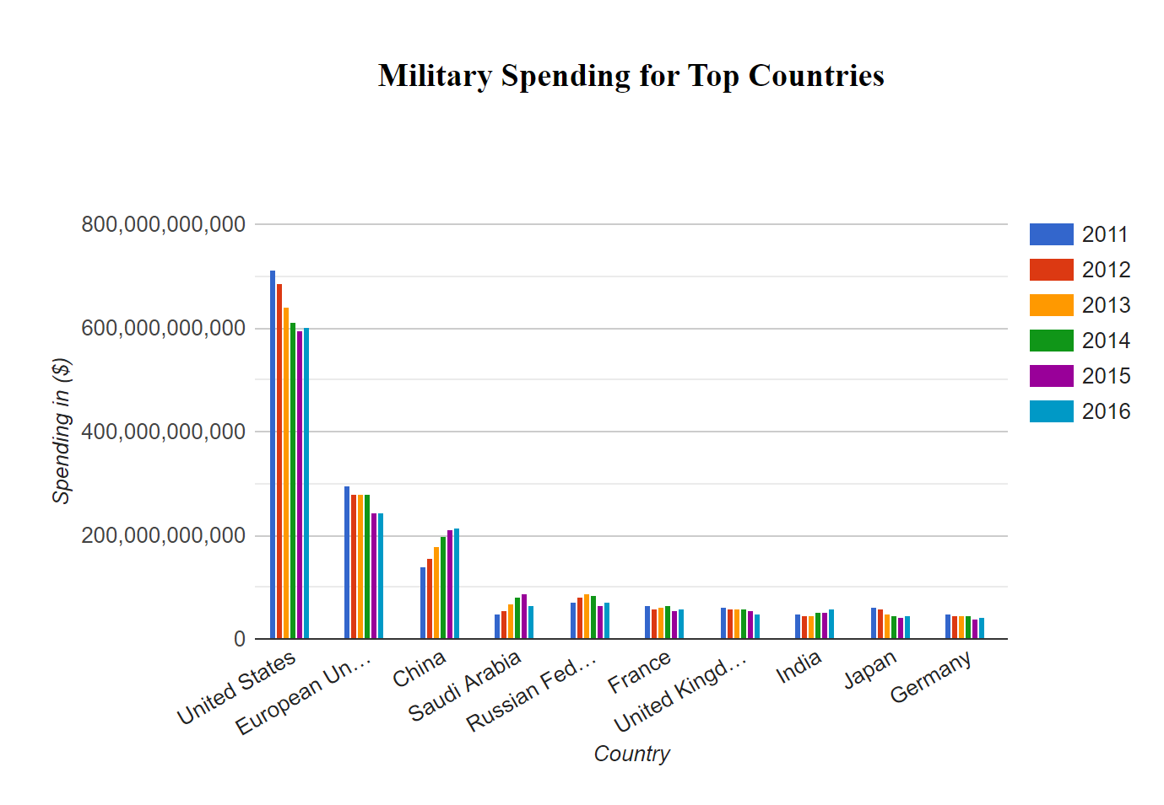
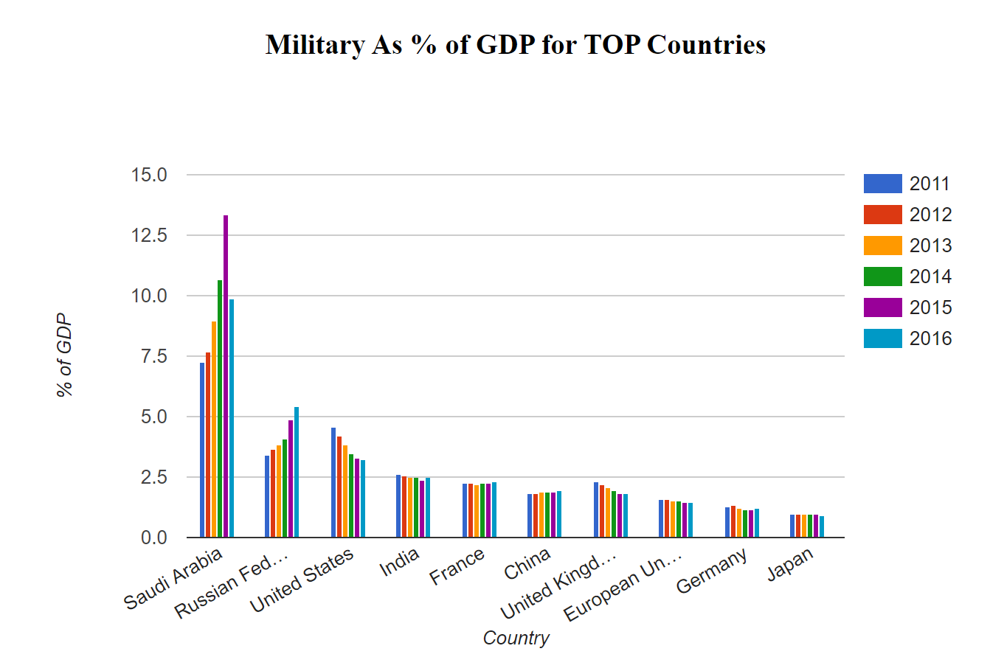
04
Military Spending VS GDP

Slide 12
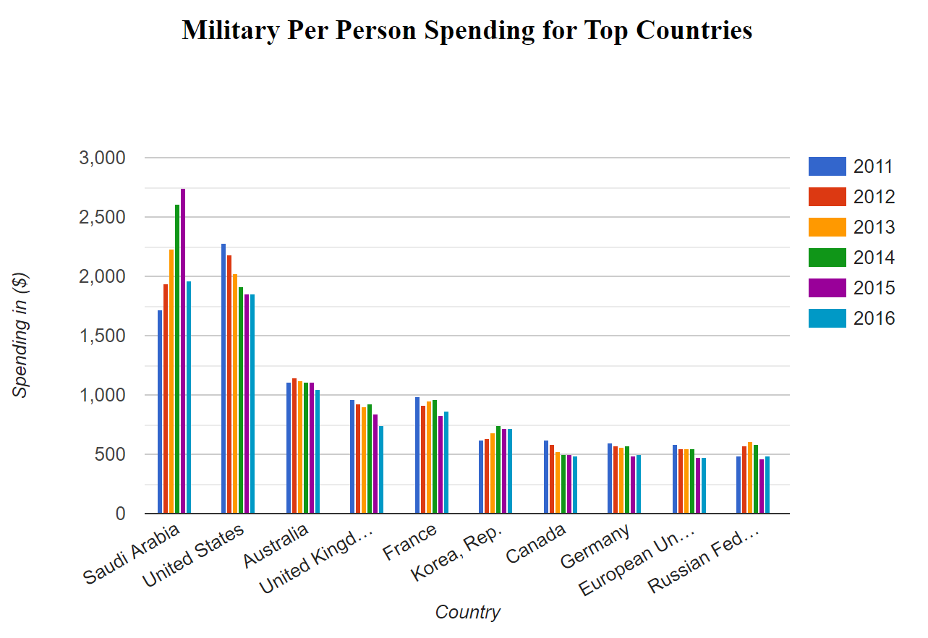
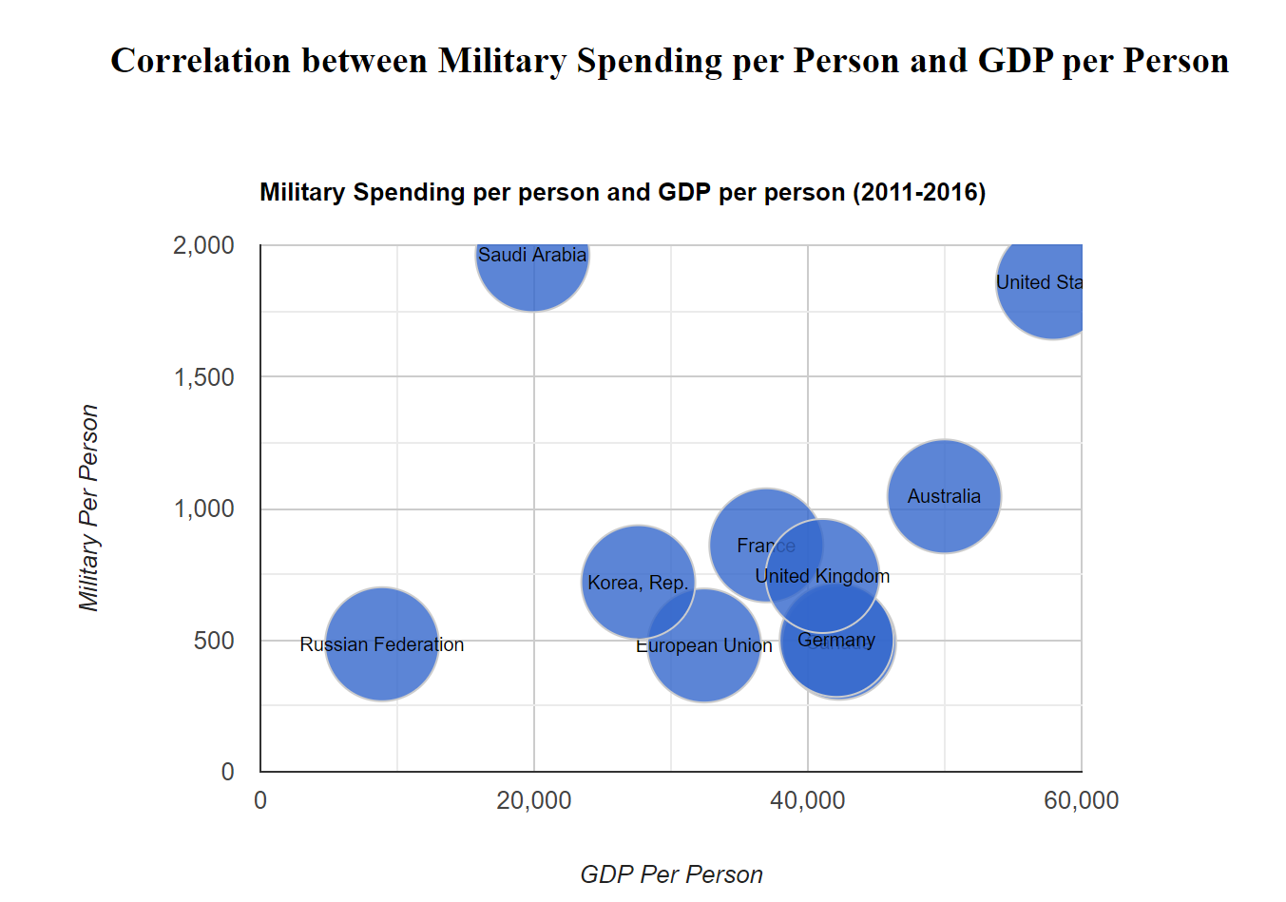
04
Military Spending VS GDP Per Capita

Slide 13
05
part
Trend & Summary

Slide 14
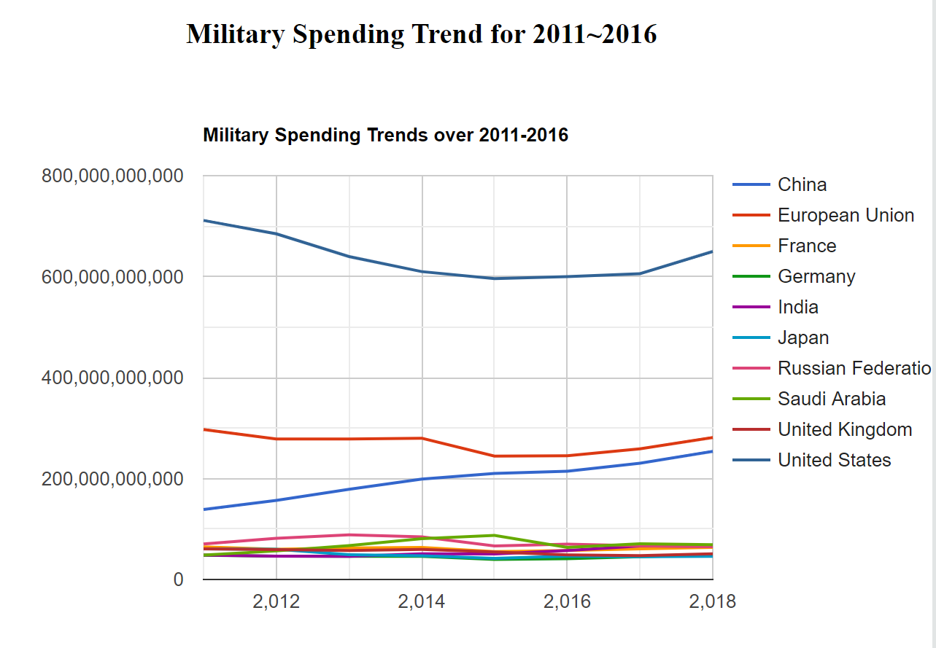
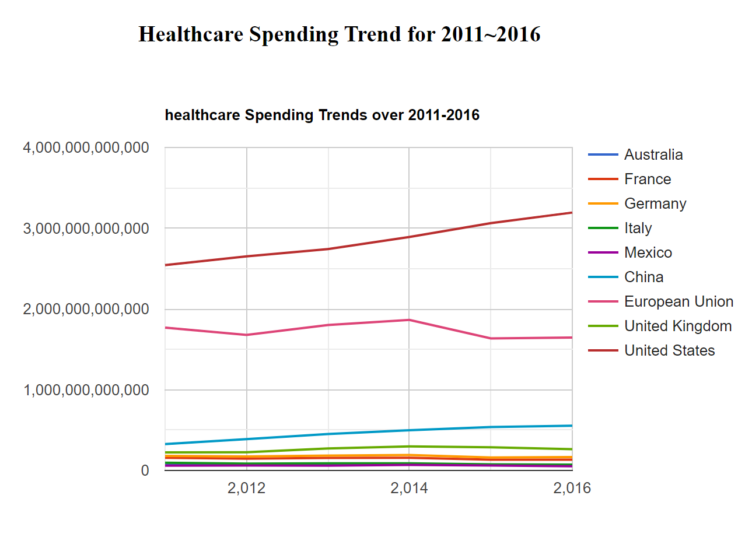
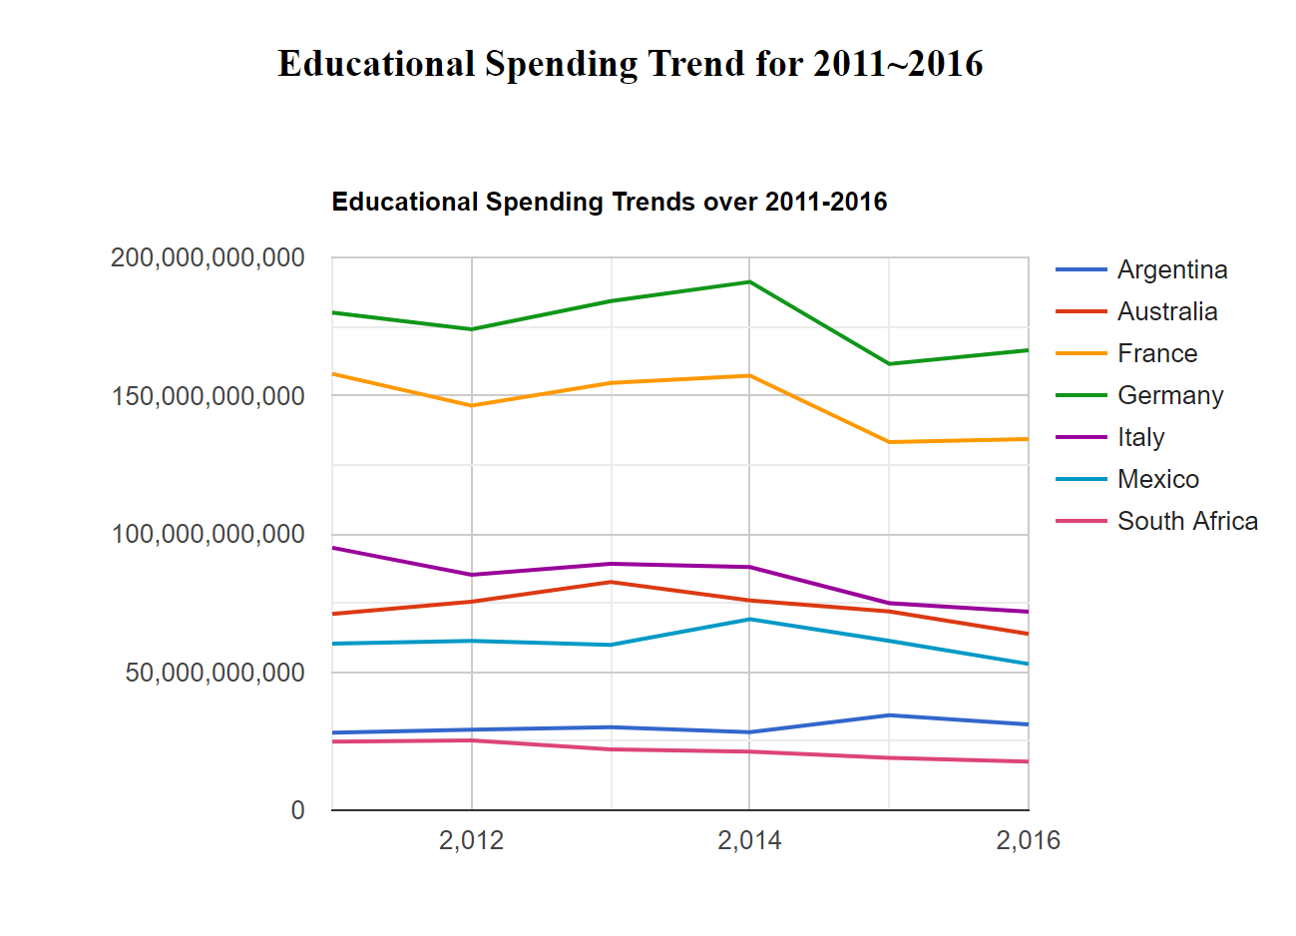
05
Trend of Military, Healthcare and Educational Spending

Slide 15
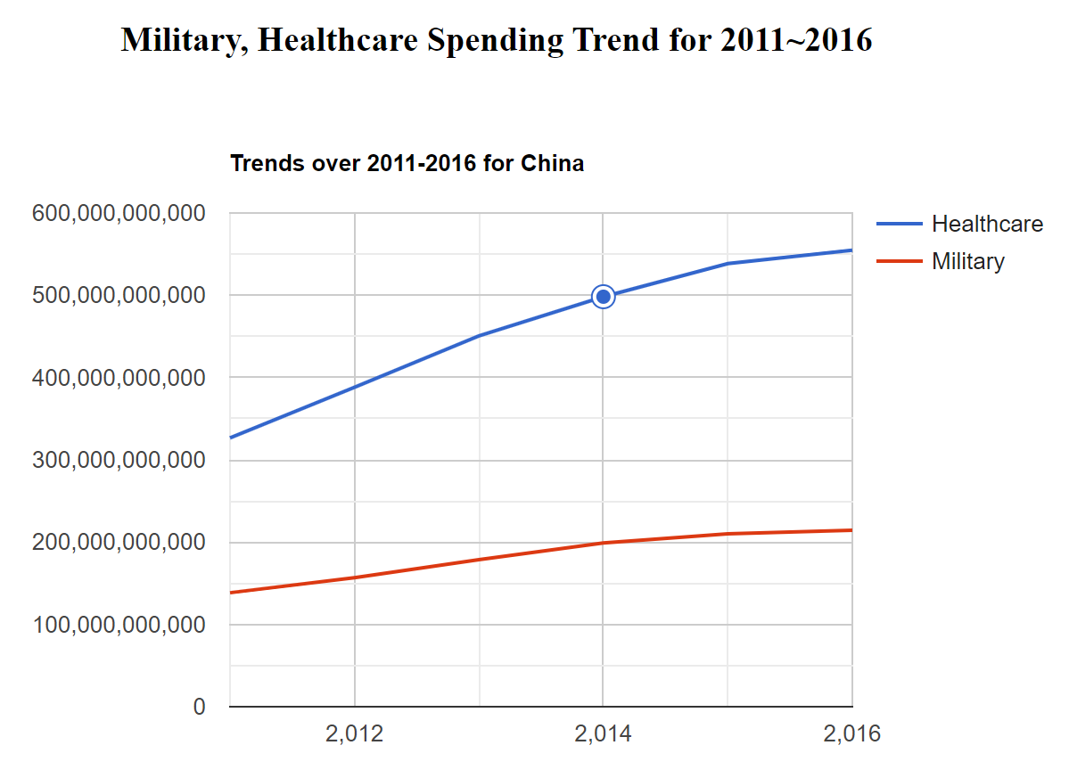

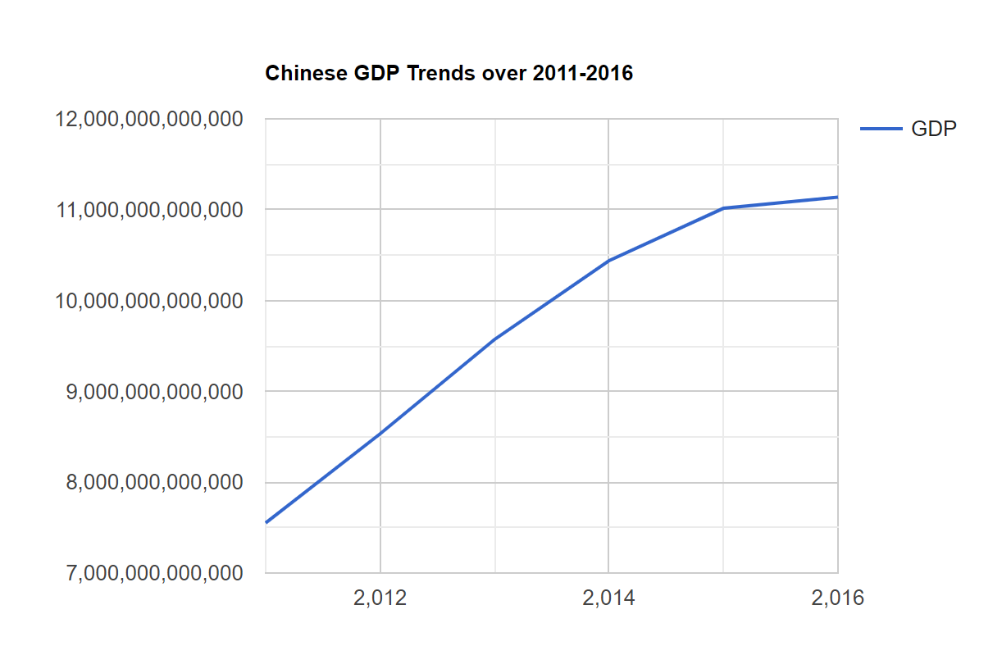
05
Highlight China
China is the only country whose GDP, Military Spending and Healthcare spending continually increase

Slide 16



